Slide 1
PROTOCOLS

Slide 2
In this section we will discuss:
TCP
IP
POP
HTTP
HTTPS

Slide 3
TCP
TCP stands for transmission control protocol.
It is connection oriented protocol.
It help to exchange the message between different devices over a network.
It lies between the application and network layers which are used in providing reliable delivery services.
It is a popular communication protocol which is used for communication over a network.

Slide 4
Features of TCP
Segment numbering system.
Flow control.
Error control.
Congestion control.

Slide 5
Advantages & disadvantages
Advantages
Disadvantages
It is reliable protocol.
It provides error checking mechanism as well as one for recovery.
It gives flow control.
It gives acknowledgment.
TCP is made for WAN(wide area network).
TCP run several layers so it can slow down the speed of network.

Slide 6
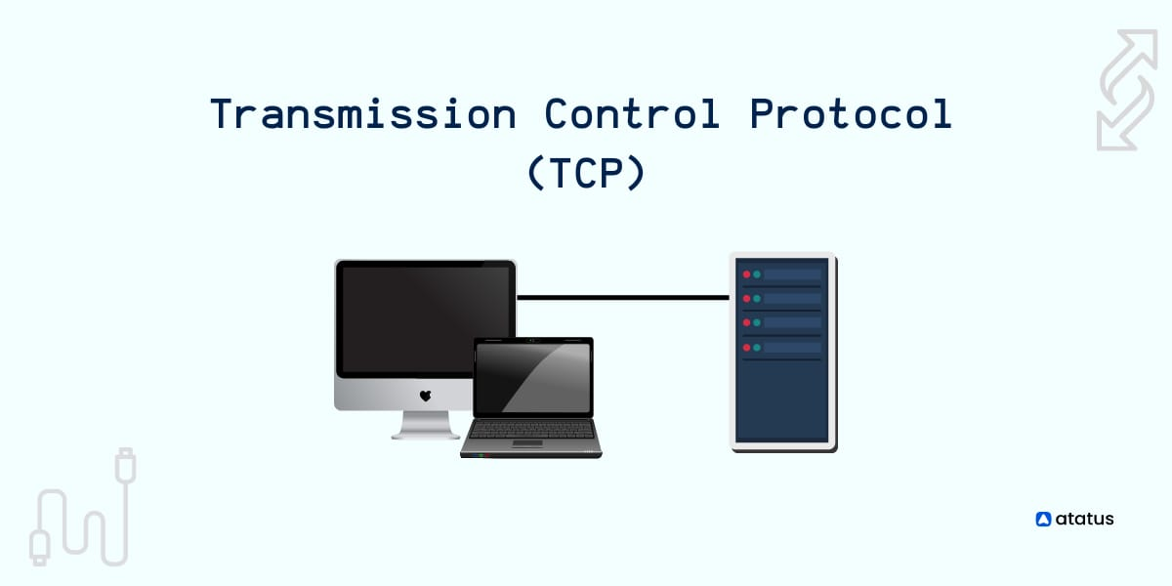

Slide 7
IP
IP stands for Internet Protocol.
It is a set of rule for routing and addressing packets of data.
It is mostly used with TCP (transmission control protocol).
Every devices connected to the internet is assign an IP addresses.
IP is the network layer services implanted by the TCP/IP protocol suite.

Slide 8
Features of IP
Connectionless – No connection with the destination is established before sending data packets.
Unreliable – Packet delivery not guaranteed.
Media Independent – Operation is independent of the medium carrying the data.

Slide 9
UDP
UDP is User datagram Protocol.
UDP is a Transport layer Protocol.
It is the part of the Internet protocol.
It is connectionless Protocols.
It have two ports: Source and Destination.
Source port – It is a 2 byte long field used to identify the port number of the source.
Destination Port - It is a 2 byte long field used to identify the port of the destination packet.

Slide 10
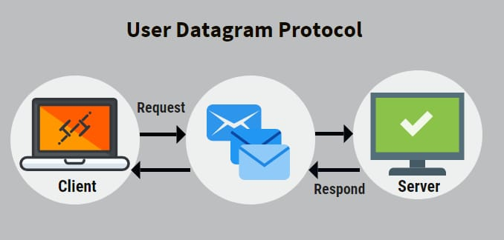

Slide 11
POP
POP stands for post office protocol
It is type of computer networking and standard protocol
It is used for extract and retrieves email
It is work in SMTP
SMTP Pushes message them to Server

Slide 12
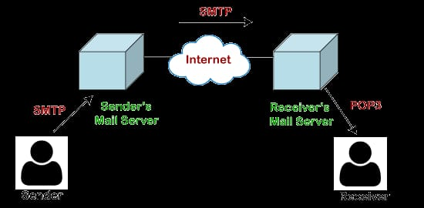

Slide 13
HTTP
It is stand for hyper text transfer protocol
It is designed for client server principle
It allows a client system for establishing a connection with the source machine for making a request
It is full filled client request
It is a protocol used to access the data on WWW
HTTP protocol can be used to transfer the data in the form of Plain text, hyper text, audio , video

Slide 14
Features of HTTP
Connection less : the connection between client and server exist only during the current time and Response time only
Media independent : http protocol is media dependent ass data can be sent as long as both the client and server know how to handle the data content
Stateless : both the client and server do not retain the information between various request of the web pages

Slide 15
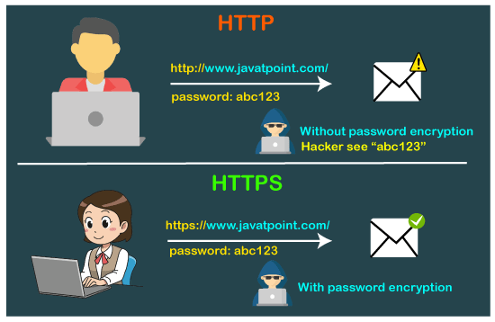

Slide 16
HTTPS
HTTPS stand for hyper text transfer protocol secure
It is the secure version of HTTP
It is increase security of data transfer
It is particularly important when user transmit data such as by logging bank account email services etc

Slide 18
THANK YOU!!

